Slide 1
QA Cheatsheet
How to QA test features at POWR

Slide 2
Testing Basics

Slide 3
POWr Testing Philosophy
We want our users to have an amazing experience with POWr.
When testing new features, our primary concerns are:
Does the new feature work as intended?
Is it clear to the user what the new feature does?
Does the product as a whole still work as expected for existing users?
Did we avoid adding unnecessary complexity to the product?

Slide 4
POWr Testing Philosophy
Please always make sure that you understand the feature you are testing.
It’s also important to understand what the existing functionality is and what will change with the new update.
Sync with the support team if you are unsure what common problems are with the existing feature!

Slide 5
What we test and why
All code updates we make go through code review and manual QA testing. We do not launch anything without testing.
We test:
New features
New plugins
New integrations
Bug fixes
Refactored code
Architectural updates (deployment, server updates, etc.)

Slide 6
What we test and why
We test everything because we want to build the best plugin library in the universe.
We test everything because we take pride in our work and we do not want to launch anything that could keep POWr users from having a great experience.

Slide 7
Testing Flows
The process for knowing what to test and how to log bugs is outlined here: POWR QA Testing Flow

Slide 8
POWR’s Testing Servers

Slide 9
POWR’s Testing Servers
We use the following environments for testing:
https://www.powr-staging.io
https://powr-alpha.herokuapp.com
http://PR.powr-staging.io
Localhost:3000 (only if you have the POWR environment set up)
All updates need to be tested on staging before they go live.
For unstable updates, you may be asked to test on Alpha.(IMPORTANT: Platforms cannot be tested on Alpha)

Slide 10
Testing Plugin Settings

Slide 11
Different Settings To Test
When testing new features, test in the following places:
Standalone
Popup settings / Share
Platforms:
Weebly
Wix
Shopify
Webydo
Jimdo
BigCommerce

Slide 12
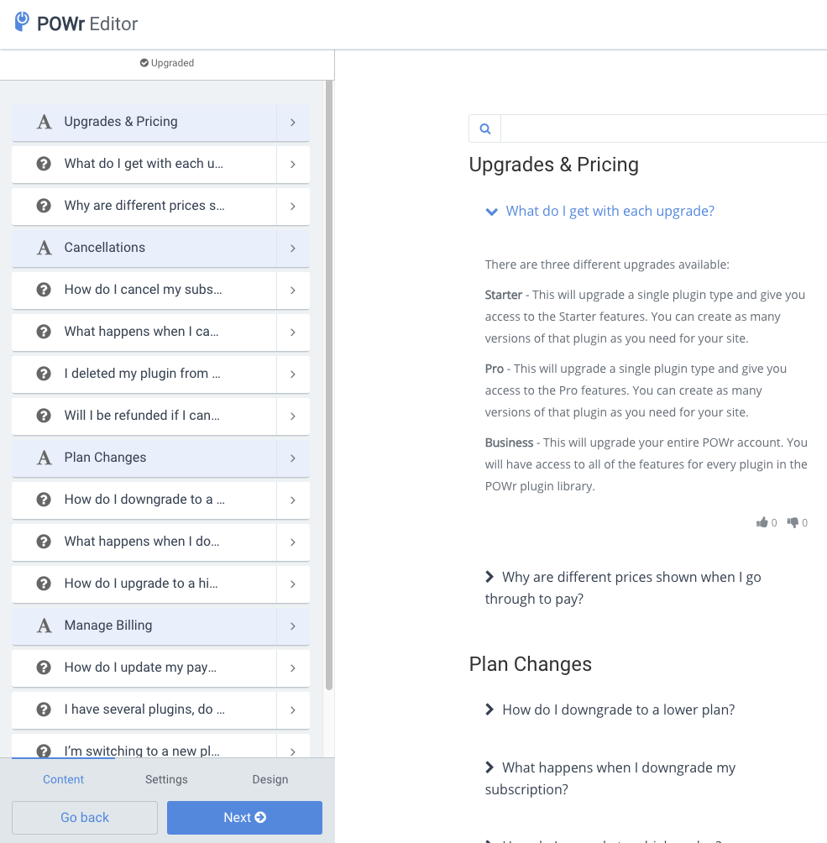
Testing Standalone

Slide 13
Standalone
Standalone (e.g. https://www.powr.io/plugins/faq/standalone ) is the most common testing environment you’ll be in.
You’ll have full access to all settings and admin features from there.
Standalone lets you test as a typical user editing their plugin on powr.io or on a platform like Shopify or WordPress.
Standalone is the first place you should test new features.

Slide 14
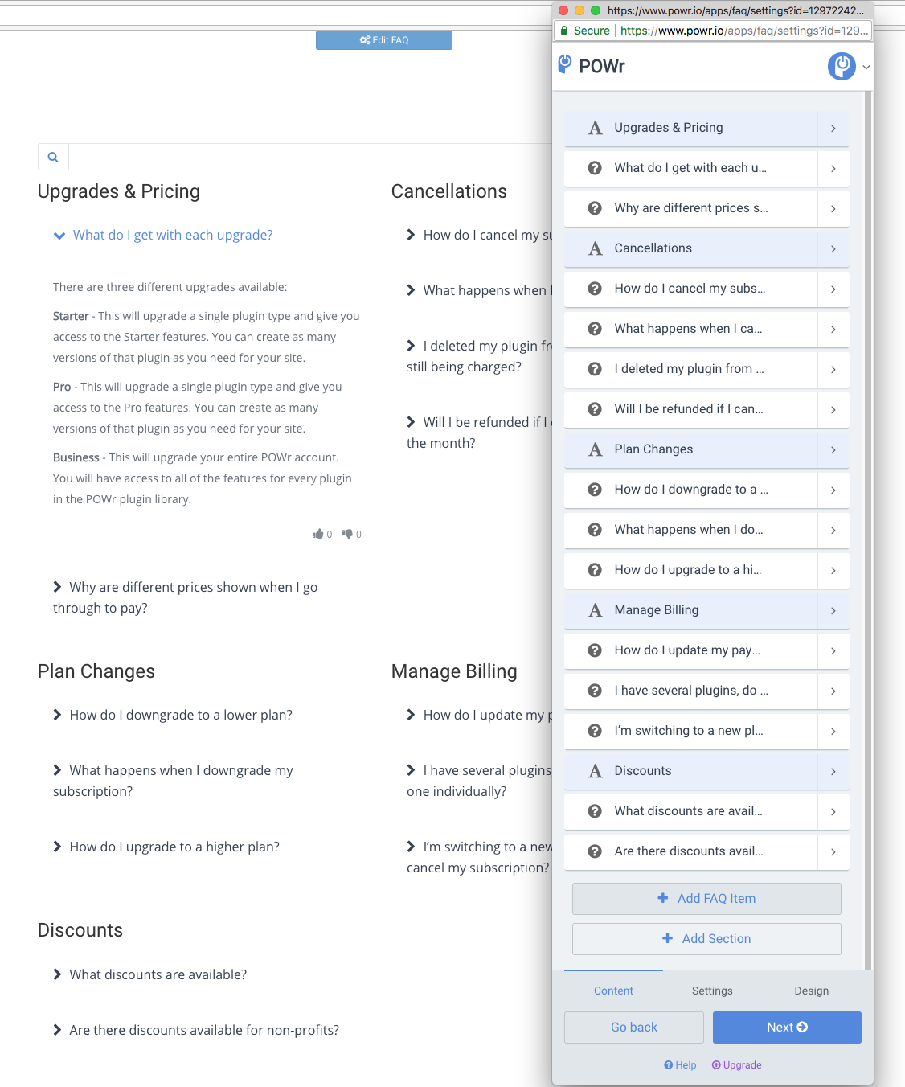
Testing Popup Settings / View

Slide 15
Popup settings / Live Site
“Popup settings” refers to the POWR editor that pops out when the user edits on a live website.
When someone asks you to test the popup settings, clarify if they are referring to the Editor or the Popup plugin!

Slide 16
Popup settings / Live Site
The easiest way to test in the popup settings is by opening the View link for a plugin:
https://www.powr.io/plugins/faq/view?id=12972242&mode=page
Replace “standalone” with “view” in your plugin URL. Add “&mode=page” to the end of the URL.
Click on “Edit” on that page and the popup settings will appear.

Slide 17
Popup settings / Live Site
Testing the View is also important because some bugs only happen in the App View, not in the settings.
Test the plugin as if you were the end-user viewing it on a live website. Fill out forms, submit payments, search for map locations, etc.
Interacting with the plugin like an end-user is important to find the most frustrating kind of bugs - those that prevent our users from growing their small business online.

Slide 18
Testing In Platforms

Slide 19
Common issues with the popup settings / Embedded
Plugin doesn’t load in Embedded / Share
Navigation in popup settings is broken (tabs hidden by nav bar, “Back” buttons in drilldowns not showing, etc.)
Pricing table doesn’t allow user to select a plan
Flow doesn’t make sense (user sees install steps despite already having plugin installed on site, missing login step for logged out users, etc.)

Slide 20
Testing in Platforms
Testing in platform is important because those integrations behave differently from our regular editor.
Wix settings use Wix’s UI library and are altogether very different from the POWR Editor
Weebly settings use a slightly wider Editor with a few unique features
Shopify uses regular standalone but the flow for upgrading and installing differs from what a user sees on POWr

Slide 21
Weebly

Slide 22
Weebly: “Backend” vs “Toolbar”
Backend install (Popup, Notification Bar, Chat):
The user installs from the App Center. The plugin is automatically added to all pages. The user edits their plugin via Site Settings > My Apps.
Toolbar install (all other plugins):
The user installs from the App Center and drags the POWr element from the toolbar into their site as an inline element.

Slide 23
Weebly: “Freebly”
Freebly plugins: Countdown Timer, Multi Slider, Popup
We offer some plugins for free in Weebly.
When the user installs from the App Center, we immediately unlock a Business trial to give the user full access to all features.
The user should never see any upgrade prompts in the editor or elsewhere.

Slide 24
Weebly: Production
Weebly is a free platform. You’ll get the most authentic experience by creating a new Weebly site.
Log out of your powr.io account
Go to weebly.com
Create a new account with an email that’s not already tied to a POWR account
Go to https://www.weebly.com/app-center/search/powr
Install a “Backend”, a “Freebly”, and a “Toolbar” plugin
Edit the plugins
Publish and view your site

Slide 25
Weebly: Staging
Go to http://powr-staging.io/admin/platform_dev_controls
Select the Weebly or Weebly Backend plugin you wish to test and click “Go”
Go to https://www.weebly.com/developer-admin/ (log in with ben@powr.io login in LastPass)
Select Backend Staging (for “Backend” plugins) or POWR Staging (all other plugins)
Navigate to the “Quick Action”Choose “Install to Site” to install the plugin to a test site
Go to the test site and test the plugin!

Slide 26
Weebly: Localhost
Go to https://localhost:3000/admin/platform_dev_controls
Select the Weebly or Weebly Backend plugin you wish to test
Go to https://www.weebly.com/developer-admin/ (log in with ben@powr.io login in LastPass)
Select POWR Backend Local (for “Backend” plugins) or POWr Local (all other plugins)
Choose “Install to Site” to install the plugin to a test site
Go to the test site and test the plugin!

Slide 27
Common issues with Weebly settings
Settings don’t load
Top or bottom nav are blocking other elements in settings
General CSS issues (the editor is slightly wider)
Issues with “Freebly” plugins flow
Issues with “backend” plugins flow

Slide 28
Wix

Slide 29
How to create a new testing site on Wix
Go to https://www.wix.com , Sign in with the powrhelpsocial@gmail.com in the LassPass
Click on + Create new site > choose a type of a website > Click Start now > pick the website template > click on it > Edit - wix website editor should open.
Click Publish - “Choose domain before you publish” popup should open, put the radio button on “Get a Free Wix.com domain”, customise the domain of your website, click Save & Continue.

Slide 30
Wix: Production
Wix is a free platform. You’ll get the most authentic experience by creating a new Wix site.
Log out of your powr.io account
Go to wix.com
Create a new account with an email that’s not already tied to a POWr account
Go to https://www.wix.com/app-market/search?query=powr
Install any POWR plugin (but usually Form Builder)
Edit the plugin
Publish and view your site

Slide 31
Wix: Staging
Go to http://www.powr-staging.io/admin/platform_dev_controls
From the dropdown select the Wix plugin you wish to test and click “Go”
Next click on https://dev.wix.com/apps it will open in a new tab (log in with powrhelpsocial@gmail.com login in LastPass)
Select WixStaging (All Apps)
Click “Test App > In Editor” and select a test site to install to > Click Add to site> The app should appear in your site > Click Settings.

Slide 32
Wix: Localhost
Go to https://localhost:3000/admin/platform_dev_controls
Select the Wix plugin you wish to test
Go to https://dev.wix.com/apps/my-apps (or https://dev.wix.com/dc3/my-apps) (log in with powrhelpsocial@gmail.com login in LastPass)
Select Wix Local
Click “Test App > In Editor” and select a test site to install to
Go to the test site and test the plugin!

Slide 33
Common issues with Wix settings
Settings don’t load
Components that shouldn’t be there (such as POWR navbar) show up
Components look funky in Wix settings
Form Builder: Form Response Dashboard looks strange or doesn’t load for users without an active POWR session

Slide 34
Shopify

Slide 35
Shopify: “Freemium” vs “Free” vs “Free Trial”
Freemium:
Freemium plugins come in a free and a paid version
Free (Comments, Social Feed):
Free plugins have all features unlocked. No upgrades are shown to the user.
Free Trial (Countdown Timer, Image Slider, + a few more):
Free Pro trial (7 days). Upgrade required to install.

Slide 36
Shopify: Production
Shopify is not a free platform. However, you’ll get the most authentic user experience by creating a new trial account.
Log out of your powr.io account
Go to shopify.com
Create a new account with an email that’s not already tied to a POWr account
Go to https://apps.shopify.com/partners/powr-io
Install any Free, Freemium, and Free Trial POWr plugin
Edit and install the plugin

Slide 37
Shopify: Staging, pt. I
Go to http://powr-staging.io/admin/platform_dev_controls
Select the Shopify plugin you wish to test
Go to shopify.com/partners> Log in> select POWr.io (log in with support@powr.io login in LastPass)
You will land in Development Stores > log into one of the available stores that has the POWR Staging plugin installed (powr-test, powrpuru)click log in
Go to Apps in the dev store and open POWr Staging.
Test your plugin! (oudated)
Go to Jotable and follow the steps in this article (outdated)

Slide 38
Shopify: Staging, pt. II
If you’re testing an update specific to the Free Trial or Free flow, you won’t want to test with an existing site.
Testing with an existing site will NOT give you the correct trial or free status.
Instead, follow the steps in the next slide.

Slide 39
Shopify: Staging, pt. III
Go to http://powr-staging.io/admin/platform_dev_controls
Select the Shopify plugin you wish to test
Create a new Development Store
Once created, go to Settings > General and change your store email to one not already tied to a POWr account
To add staging to your store open this link: https://www.powr-staging.io/plugins/shopify-staging/shopify_authenticate?shop=powr-test.myshopify.com (replace powr-test with your store’s name)
Install the plugin and test it!

Slide 40
Shopify: Localhost, pt. I
Go to http://localhost:3000/admin/platform_dev_controls
Select the Shopify plugin you wish to test
Go to shopify.com/partners and select POWr.io (log in with support@powr.io login in LastPass)
Go to Development Stores and log into one of the available stores that has the Shopify Local plugin installed (powr-test, powrpuru)
Go to Apps in the dev store and open Shopify Local.
Test your plugin!

Slide 41
Shopify: Localhost, pt. II (testing different flows)
Go to http://localhost:3000/admin/platform_dev_controls
Select the Shopify plugin you wish to test
Create a new Development Store
Once created, go to Settings > General and change your store email to one not already tied to a POWR account
Open this link: https://localhost:3000/plugins/local-dev/shopify_authenticate?shop=powr-test.myshopify.com (replace powr-test with your store’s name)
Install the plugin and test it!

Slide 42
Other Platforms

Slide 43
Webydo
Our Webydo integration uses a different color scheme for the POWR Editor. Webydo is not a critical platform for us.
We only test in Webydo if the update does one of the following:
Introduce or change a new settings component, such as a new font picker
Make updates to the CSS of our pricing table

Slide 44
Jimdo
Our Jimdo integration uses the regular popup settings. Only the install flow is different:
The user finds the POWR element in the Jimdo editor, opens the popup settings, then creates a POWr account.
We only test in Jimdo if the update does one of the following:
Change the edit/signup flow
Make changes to our mini market

Slide 45
NOTE: Auto-Login
We use auto-login in many platforms - Weebly, Shopify, Wix, BigCommerce, Lightspeed, etc.
This means that you are likely to always be testing as the same user when testing via staging or localhost.
It’s important that you always smoke test as a regular (non-admin) users when an update goes live!

Slide 46
Testing In Different Browsers

Slide 47
Cross-browser Testing
For most updates, we are not overly concerned about the feature breaking in a specific browser.
For all bigger projects and updates, we check if settings and view work correctly in at least the following browsers:
Chrome (latest version)
Safari (latest version)
Firefox (latest version)
IE11 (discontinued by Microsoft)
Microsoft Edge

Slide 48
Mobile Testing
Settings updates do not need to be tested on mobile devices. Most of our users do not edit their plugins from a phone.
We do have some users editing in iPads and touchscreen Chromebooks. We will usually hear from those users if something no longer works for them. 🙃
Please do check if the app view works correctly on mobile devices. This is especially important for forms and all of our payment plugins.

Slide 49
Testing Payments
(POWR Upgrades)

Slide 50
Testing POWR Upgrades
Testing payments and making sure upgrading still works is worth testing for any updates that touch the pricing table or general JavaScript of the site.
You’ll want to test on the following pages:
/plugins/form-builder/standalone
/plugins/form-builder
/pricing
/business
(Popup settings)

Slide 51
Testing POWr Upgrades: How to pay
Test both credit card and PayPal payment using the following:
PayPal: Sandbox set up on staging and localhost
Credit Card: 4242 4242 4242 4242 (any expiration date)
When testing on production, use any valid credit card or PayPal account.

Slide 52
Testing Shopify Payments
The Shopify payment flow is slightly different and should be tested every time updates to checkout or payment success flow are made.
Test charges are enabled for Shopify Staging and Shopify Local.
NOTE: On production, you can only test payments by creating a new store (not a Development Store) and adding a valid payment method to the trial site.

Slide 53
Testing Payments
In PayPal Button / eCommerce

Slide 54
Testing payments in eCommerce / PayPal Button
When testing the checkout flow in a POWr plugin that takes payments (PayPal Button, eCommerce, Form Builder, etc.), you can use a PayPal Sandbox account (Staging, Alpha, and Localhost only!).
We have a few default ones that you can use for testing:
Merchant account: support+merchant@powr.io (pw:12341234)
Buyer account: support+buyer@powr.io (pw: 12341234) or liza-buyer@powr.io , ( pw: 12341234)
*For Stripe use any active account

Slide 55
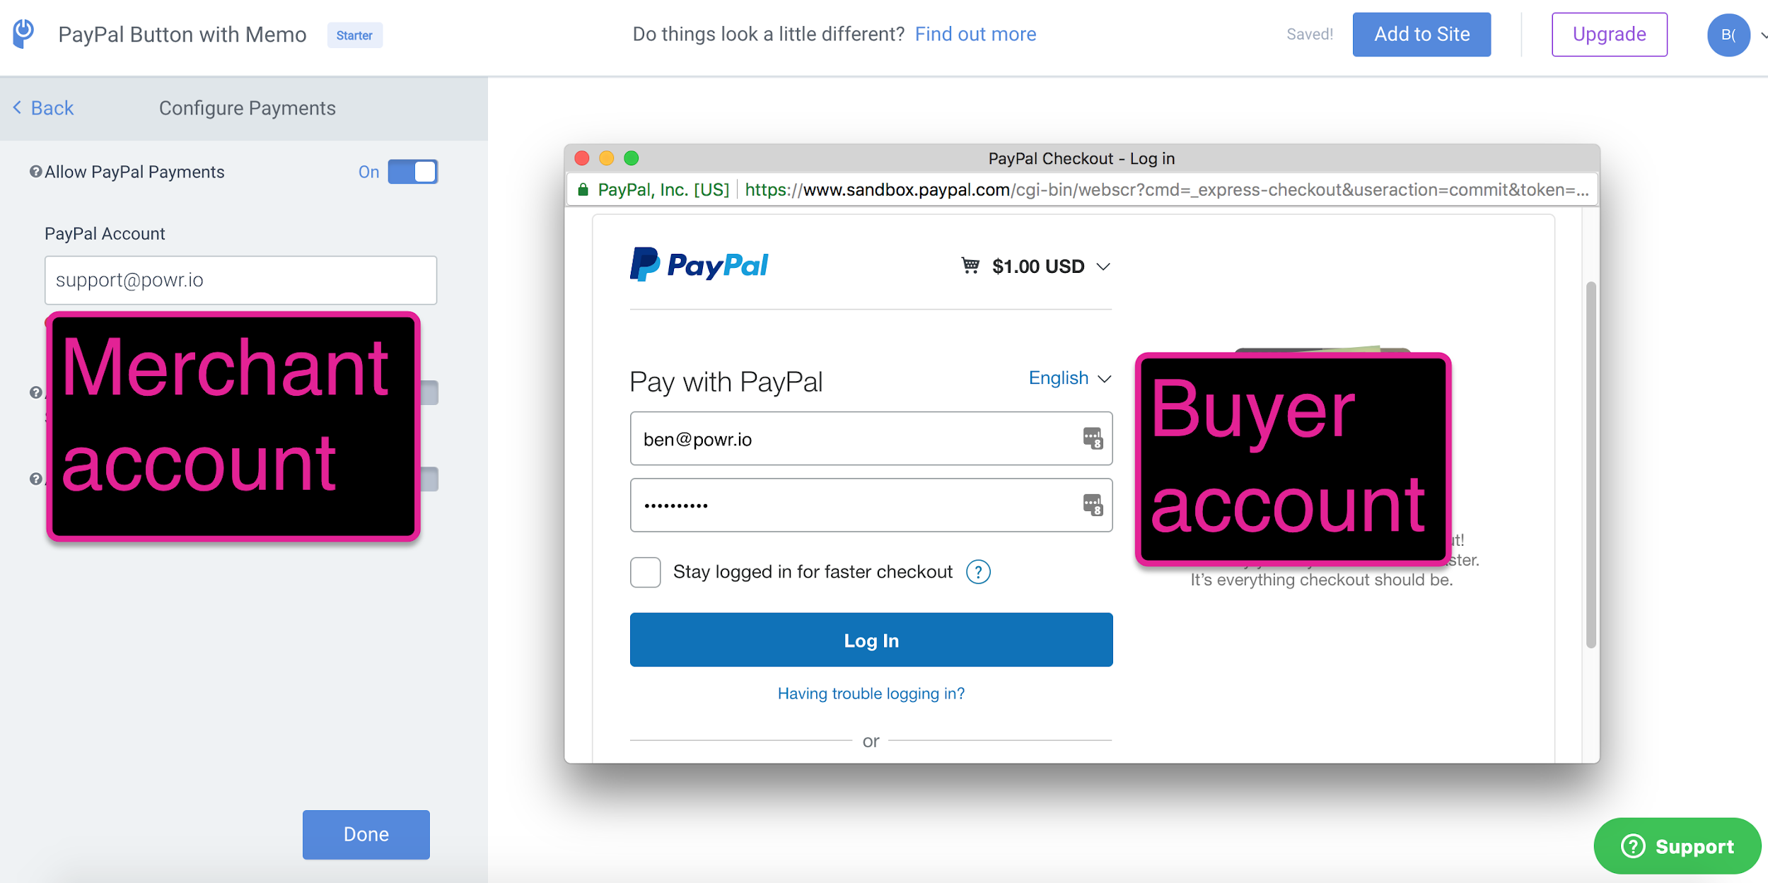

Slide 56
Notes about testing payments
If you need to see what the PayPal email notification says, you can log into the ben@powr.io PayPal account (login is in LastPass) and open the Notifications for the sandbox account you used (screenshot in next slide).
It’s also a good idea to configure notifications in your plugin to see if the email notifications to the admin reflect the right information.
Checking the Sales Dashboard is also useful for QA’ing payments!

Slide 57
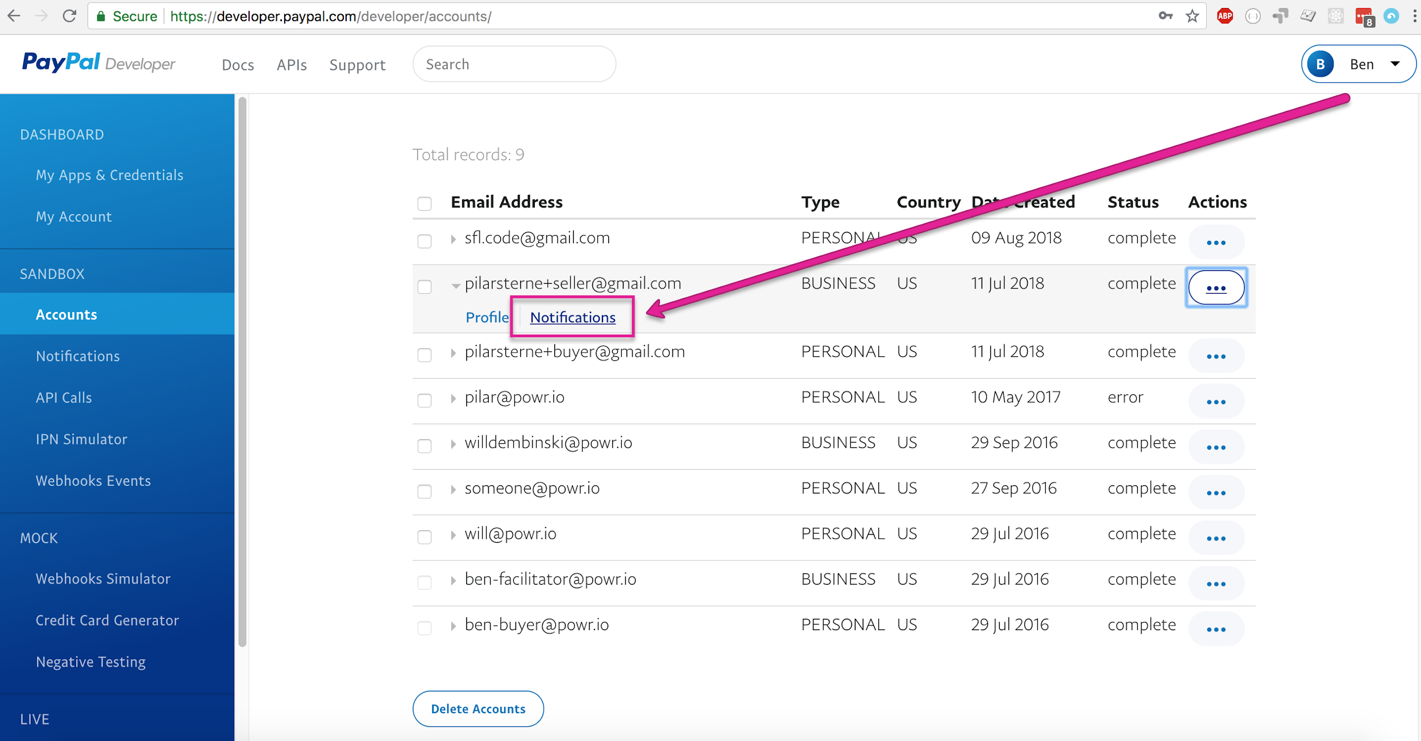

Slide 58
Notes about testing payments
IMPORTANT: eCommerce and PayPal Button use the same checkout file. When testing updates in one plugin, always check the other plugin as well. (i.e. if updates are made to PayPal Button, test the checkout in eCommerce as well)

Slide 59
Logged In vs. Logged Out
Free vs Starter vs Pro vs Business

Slide 60
Different user statuses
For any bigger update, test the update both as a logged in and a logged out user (clear your cache or open in incognito).
It’s also helpful to ensure everything works regardless of the user’s premium status:
Free user
Free trial user
Upgraded user with single app upgrade
Upgraded user with account-wide upgrade (Business)

Slide 61
Testing as an admin

Slide 62
Testing as an admin
If you don’t already have admin status on powr.io and powr-staging, ask an engineer to make you an admin.
Typically, it’s best to test any UX-heavy updates as an actual user (not as an admin).
For some updates, you will need admin functionality to thoroughly test them (such as when testing different premium levels is required).

Slide 63
Testing A/B Tests

Slide 64
Testing Google Analytics

Slide 65
Here is the steps how to test GA:
https://docs.google.com/document/d/1E2w2c3KdwKgot1WM49_XgCDKP3prCtV7s62_xQkErhY/edit?usp=sharing

Slide 66
WIP :)

Slide 67
Addendum

Slide 68
Addendum
POWr script, local:
<script src="//localhost:3000/powr_local.js?external-type=html"></script>
POWr script, staging:
<script src="//www.powr-staging.io/powr_staging.js?external-type=html"></script>
Email aliases:
You can create an infinite number of email addresses using the “+” icon after your actual email name, like: pilar+shopifytrial@powr.io

